Slide 1

A review of computational approaches to predict Enhancer-Promoter Interaction and Pseudouridine Modification
Sourajyoti Datta
Supervisor: Muhammad Nabeel Asim
Thesis motivation
Summer Semester 2022
Notes:
Hello Everyone!
I am Sourajyoti, a Master’s Student in the department of Computer Science.
And today I shall be presenting our study on the application of computational methods in two aspects of molecular biology and genetics.

Slide 2
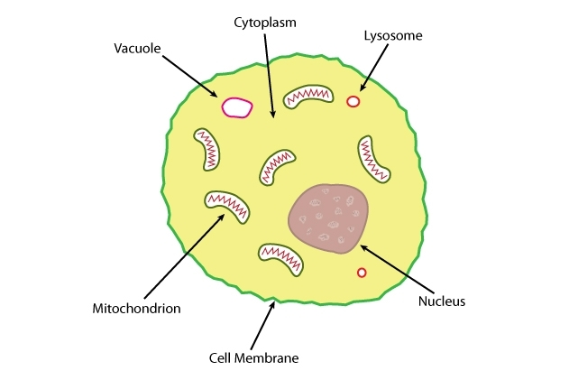
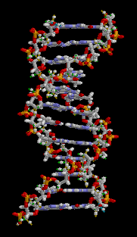
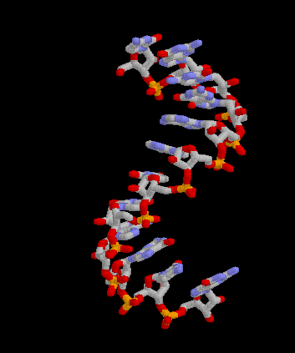
Concepts of biology
Cells
Basic building block of all living organisms
Contains genetic material
Genetic information of an organism
Defines the form and function of the organism
Defines all biological/biochemical activities
Preserved in nucleic acids
Nucleic acids
One of the macro-molecules essential for life
Composed of Nucleotides
Deoxyribonucleic acid (DNA)
Two strands of polynucleotide chains in a double helix structure
Ribonucleic acid (RNA)
A single strand of polynucleotide chain wrapped on itself
Fig: Outline of an animal cell showing the nucleus, cell membrane and some other organelles [1]
Fig: DNA
Fig: RNA
Notes:
To begin with, let us take a lookback at living organisms and genetics, which forms the core of modern biology.
First thing, I presume everybody here knows, is that almost all living organisms on our planet are made up of cells.
These cells contain the genetic information of the specific organism it belongs to.
The genetic information encodes the form and function of the organism, thereby defining various physical, chemical and biological properties.
For e.g., what the organism consumes for energy, what its physical structure is, how it reproduces, etc.
There exists various organic macro-molecules which are essential for life.
One of these molecules is Nucleic-Acids. And these acids encode the genetic information within them, in very long chains of polynucleotides.
If you look at the DNA here, you can see the helical structure, formed by two strands of polynucleotide chains wrapped around each other.
Similarly, RNA is but a single strand of polynucleotide chain wrapped on itself.

Slide 3
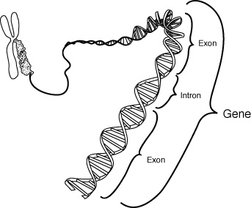
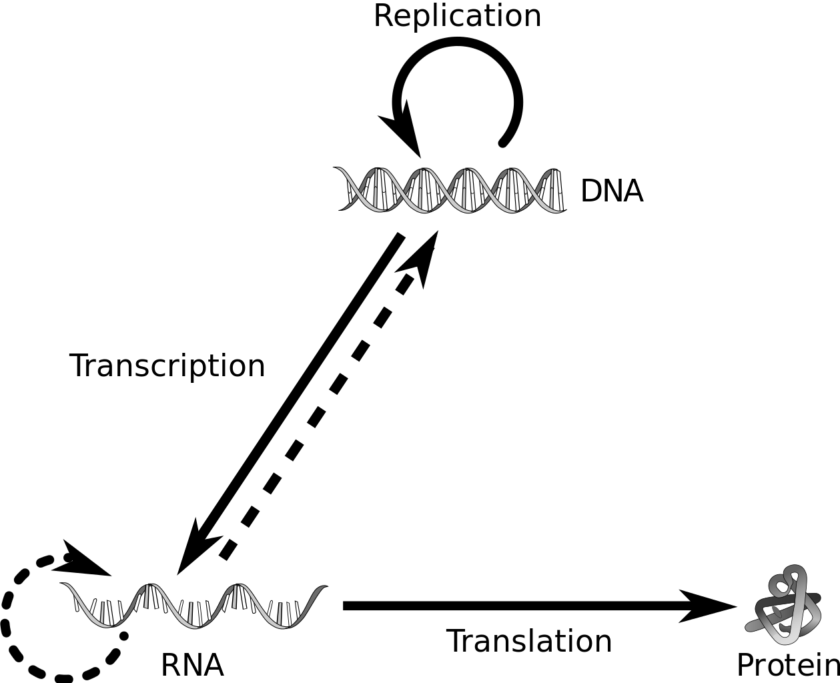
Central Dogma of Molecular Biology
Gene:
Contained within chromosomes
Segments of nucleotide sequence in DNA or RNA
Encodes synthesis of a product
Gene expression:
Produces functional gene products:
RNA
Proteins
Flow of genetic information:
DNA is copied to create RNA (DNA Transcription)
Regulation of genetic expression occurs
RNA is used to produce proteins (Translation)
Fig: Gene, segment of DNA, part of chromosome [2]
Fig: Flow of genetic information [3]
Notes:
Now, coming to genetics.
We know that chromosomes are a part of cells, and contains the DNA molecule.
Now, Genes are specific segments within the DNA as shown in the picture here.
These genes are what encodes various functions of the organism.
Specifically, it encodes what products can be synthesized from a DNA or an RNA.
This synthesis of products is referred to as Genetic Expression.
The CENTRAL DOGMA of MOLECULAR BIOLOGY states that DNA is expressed to produce RNA.
And in turn, RNA is expressed to produce proteins in the cell.
During creation of RNA from DNA, the expression of genes is regulated by certain mechanisms, which is of utmost importance to the evolution of life.

Slide 4
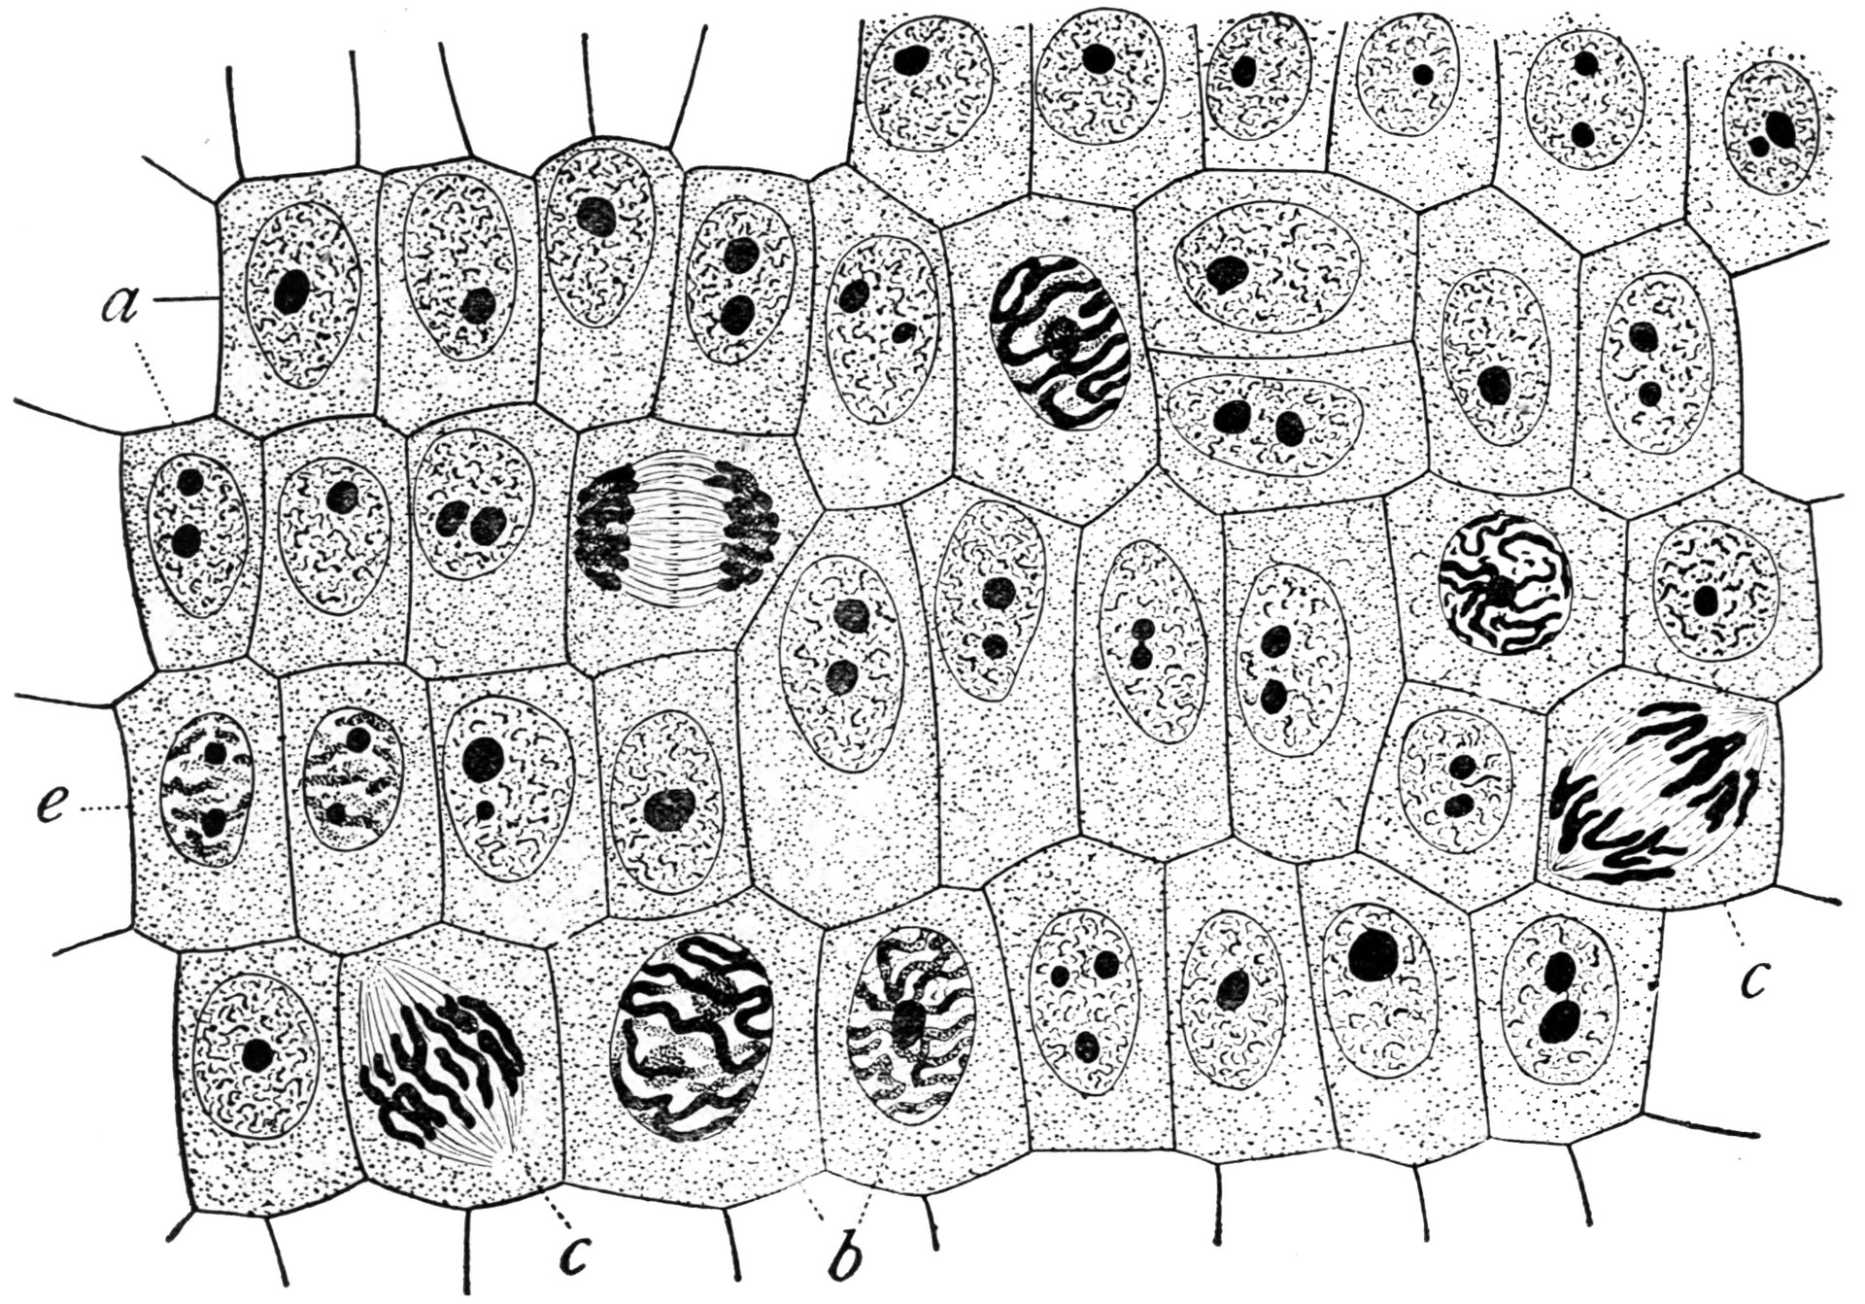
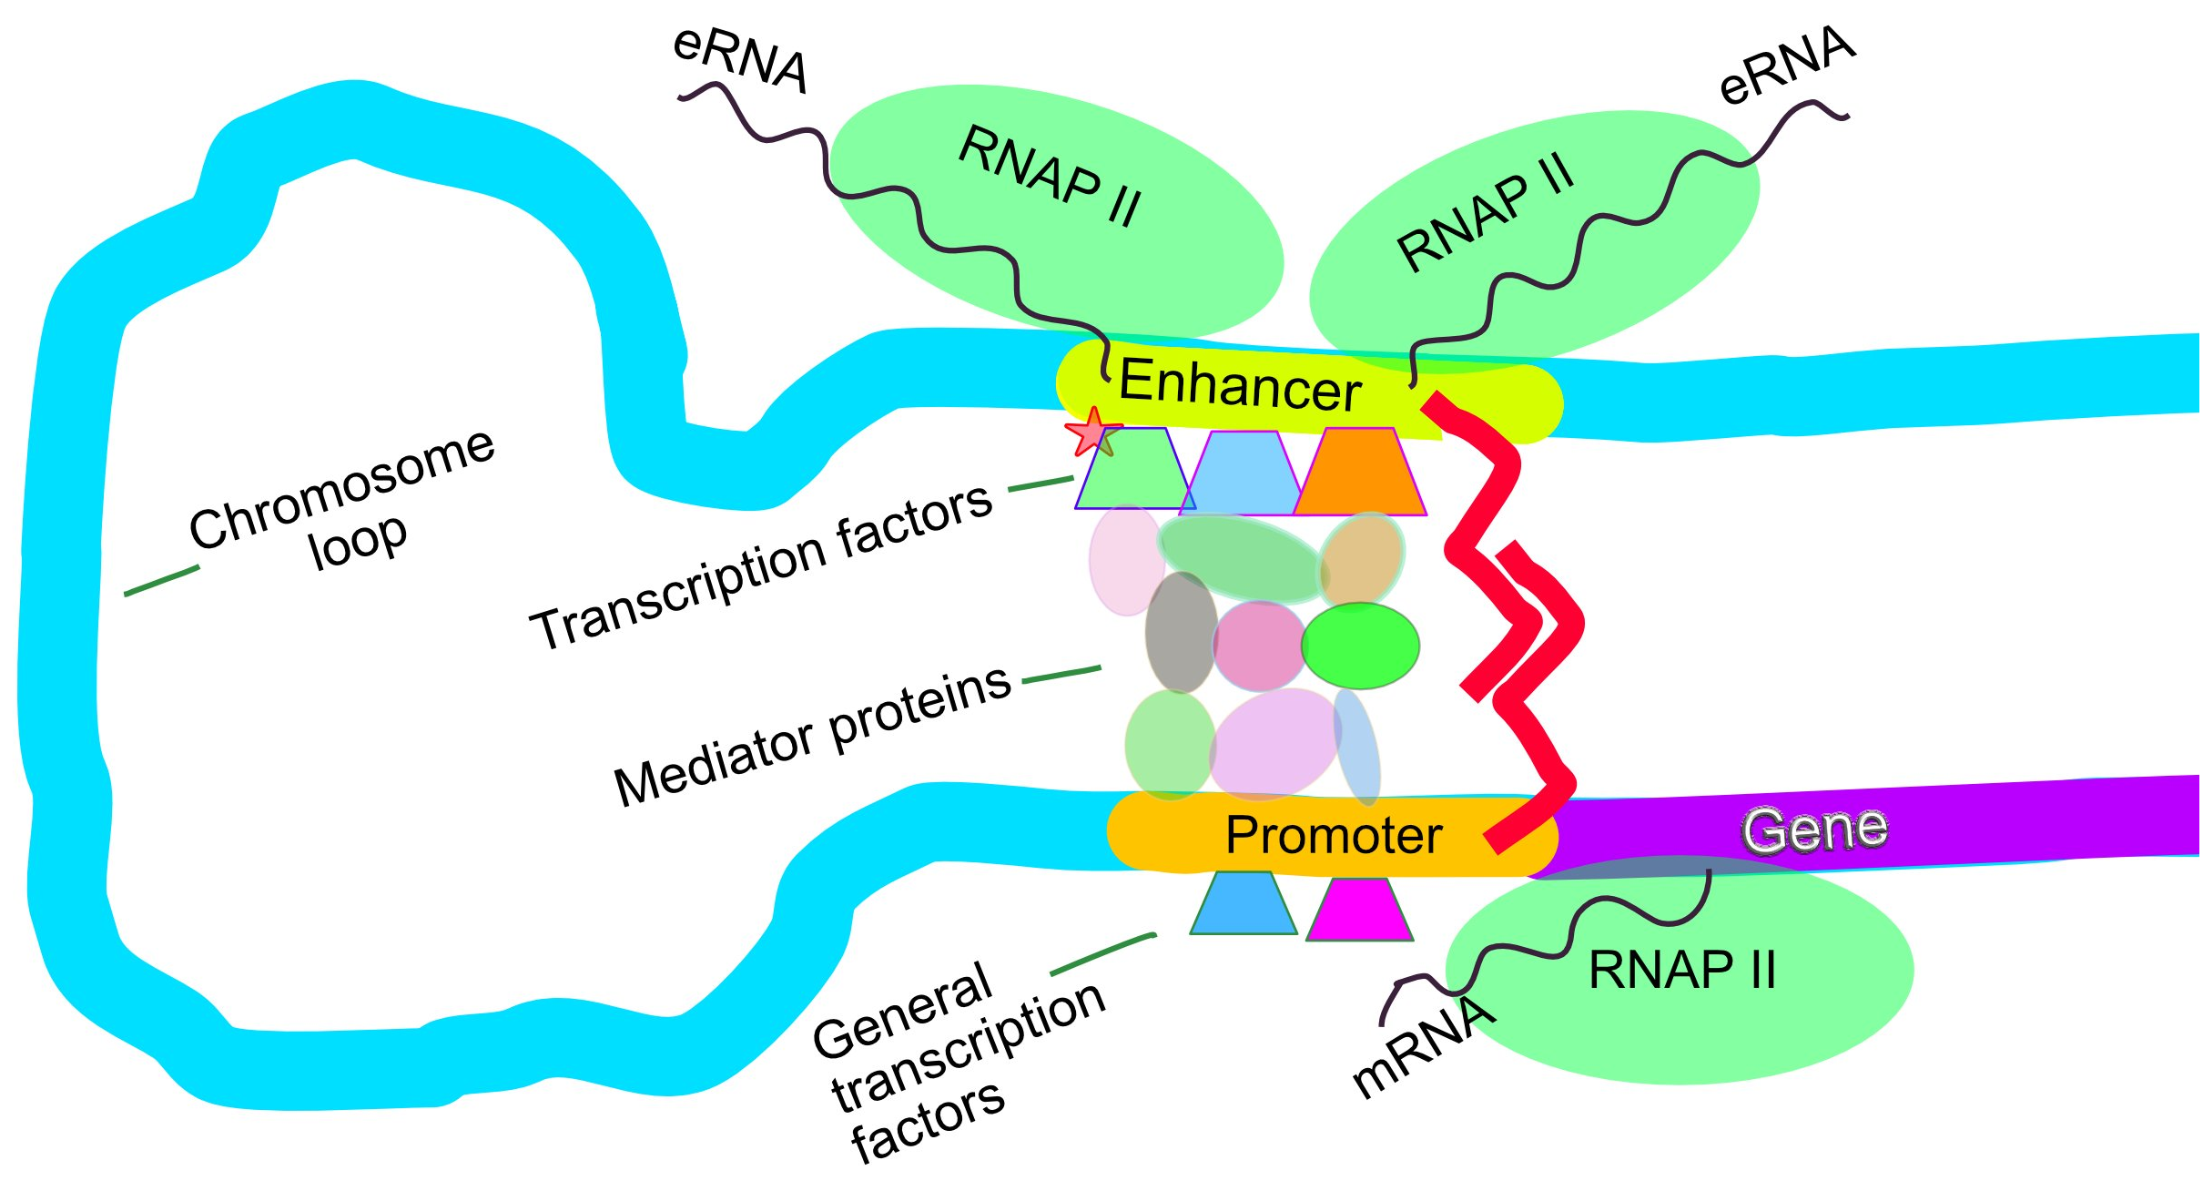
Regulation of DNA Transcription
Importance of Regulation for organisms:
Provide attributes like Versatility and Adaptability
Through Cellular differentiation and Morphogenesis
Cis-regulatory Elements – segments of DNA sequence:
Enhancers
Promoters
Promoters define the Transcription Start Sites (TSS)
Enhancer-Promoter Interaction (EPI):
Occurs through DNA/Chromosome looping
Favorable folding of the genome in the 3D space
Active enhancers interact with specific promoters
Key role in Transcription Regulation
Implications in disease progression
Fig: Variety of cells in root tissue of onion [4]
Fig: Regulation of transcription in mammals (EPI) [5]
Notes:
This regulation of Genetic expression provides various attributes to the organism, like versatility and adaptability.
For e.g., through cellular differentiation and morphogenesis, a multi-cellular organism can create different kinds of cells, each different from the other in form and function.
Take a look at the image here of a tissue from the root of an onion plant, which shows the diversity of it’s cells.
Another example, is that the cells in OUR digestive system can adapt to consume different kinds of food by generating the required proteins.
As we saw before, DNA Transcription is the process where RNA is generated from DNA.
During this process, one KEY way of regulating the genetic expression is through another process called Enhancer Promoter Interaction (or EPI).
During EPI, the DNA or the Chromosome, forms a loop in the three dimensional space as shown in the descriptive image here, such that certain Active Enhancers interact with specific Promoters.
Enhancers and Promoters are called cis-regulatory elements, and they actually define where and how in the genome the transcription process starts.
There are hundreds of thousands of potential enhancer-promoter pairs that exist in the human genome alone.
This EPI process has been studied extensively, and has been found to be related to progression of diseases, amongst other things.

Slide 5
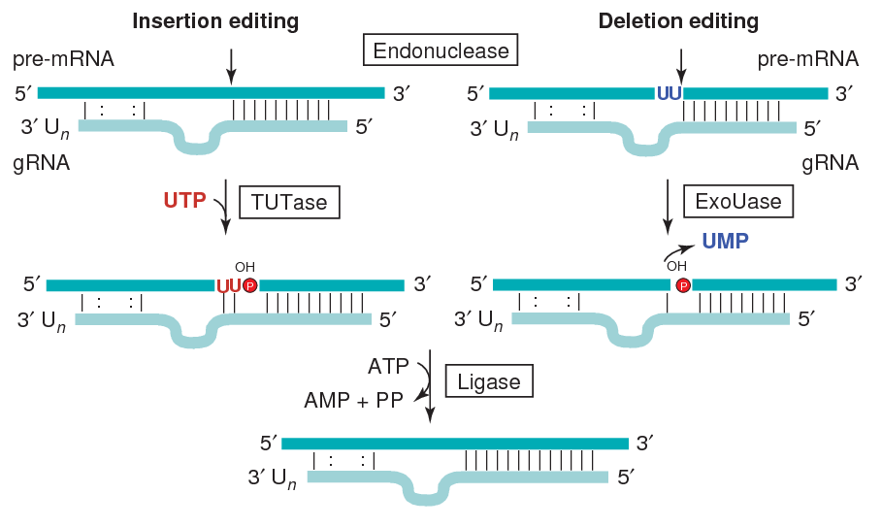
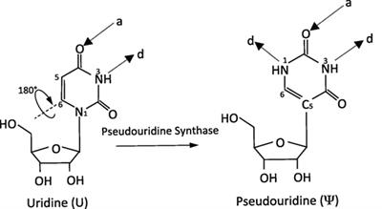
RNA Modification/Editing
RNA Modification/Editing
Post-transcriptional mechanism, occurs in the RNA molecule
Used by cells to perform specific changes in RNA sequences:
Nucleobase Insertion, Deletion, Substitution
Importance of RNA Editing:
Affects different aspects of RNA
Activity, Localization, Structure, Stability
Role in Regulation of Genetic Expression
Supports genetic code rewiring
Linked to human diseases
Pseudouridine Modification (Ψ/Psi-Sites):
Most abundant RNA modification in cellular RNA
Occurs at Uridine sites (Ψ-Sites)
5-ribosyluracil generated from isomerization of Uridine base
Catalyzed by Pseudouridine Synthase (PUS)
Fig: Sample RNA Editing: mRNA edited with gRNA [6]
Fig: Pseudouridine Modification [7]
Notes:
After transcription and following synthesis, RNA can be modified with 100s of chemically distinct modifications.
Certain modifications can regulate genetic expression of RNAs, and play a variety of roles in the cell. These roles include translation, localization and stabilization of RNAs.
Thus, the RNA can undergo genetic code rewiring.
One such modification is Pseudouridine Modification, which research shows is linked with certain human diseases.
It is one of the most abundant forms of RNA modification. It occurs at uridine sites in the RNA molecule.
The nucleobase Uridine undergoes isomerization to form Pseudouridine.

Slide 6
Motivation for computational methods
Experimental approaches have been successful in EPI and Ψ-site identification
Huge amounts of data generated for knowledge discovery:
By high-throughput sequencing technologies
Genomic and Epigenomic data
Resulted in increasing use of Machine Learning and Deep Learning approaches:
Due to overwhelming advantages of computational approaches
By high-throughput sequencing technologies
Wet lab experimental approaches:
Technically challenging with Theoretical limitations
Labor intensive
Requires skilled laboratory experience
Time consuming
Expensive
High false-negative rates
Generates ground truth data
Computational approaches:
Easier development
Comparatively, much less labor intensive
Requires coding skills
Ease of reuse, hence, saves time
Economical
Accurate and Robust
Notes:
Over the years, many experimental approaches in physical laboratories have been successful in identifying EPI in DNA and Psi-sites in RNA.
Various high-throughput sequencing methods has generated huge amounts of Genomic and Epigenomic data.
However, these wet-lab experiments are often expensive & technically challenging, with limitations.
They often prove to be labour intensive & require skilled experience, and often have high false negatives.
This has sparked the advent of computational methods as economical, accurate and robust approaches to identifying these processes. It also has the added advantage of quick cycling through experimentations.
Although, wet lab experiments are still important in generating ground truth data, and validating computationally predicted results.

Slide 7
EPI – Features
DNA Sequences as feature
Long sequences, consisting of 4 nucleobases
Adenine [A] , Cytosine [C]
Guanine [G] and Thymine [T]
Fixed length segments used as input
…..ACGACTAAACCACGTACGACTAAACCACT…..
Natural Language Processed embeddings
DNA2vec
EP2vec
Structural context of the DNA sequences
3D Chromatin Interaction features
ChIA-PET and Hi-C Contact Matrices
Distance Measures
Genomic features
Gene Expression profiles
Enhancer Gene Correlation
Gene Score
DNA Methylation
ChIP-seq peaks
Window Signal (Enhancer and Gene)
Epigenomic features
ChIP-seq profiles
RNA-seq profiles
Chromatin accessibility
DNase-seq
ChIP-seq
Notes:
Okay, so let us first look at the prediction of Enhancer-promoter interaction in DNA.
For such computational approach, the first requirement is determining important and related features.
Hence, the various studies look into 5 main categories of features.
First, DNA Sequence themselves as a feature. Here, fixed length segments of DNA denoting the Enhancer and Promoter segments are used. They are often One-hot-encoded.
Then, sequence profiling information are extracted from these sequences to form the Genomic and Epigenomic features.
As a fourth approach, structural context of the DNA sequences are used. For example, the chromatin-loop formation of the DNA strand as shown earlier.
And finally, With the advent of Natural Language Processing, word-based embeddings are also being explored.

Slide 8
EPI – Classifiers
Machine Learning approaches
Uses feature sets directly
Requires crafted features
Requires domain expertise
Feature Selection performed
To filter relevant and important features only
Forward feature selection widely used
Prevalence of Ensemble algorithms for classification:
Gradient Boosting Regression
Decision Trees
AdaBoost
Deep Learning approaches
Uses feature sets directly
Do not require hand crafted features
Feature Extraction layer
Learns and extracts features directly from data
Convolutional Neural Network layer
Extracts spatial features
Recurrent Neural Network layer
Extracts temporal dependencies
Fully Connected Neural Network layer used for final classification
Notes:
For EPI, current research implements algorithms from Machine Learning, as well as builds deep neural networks for classifying Enhancer-Promoter pairs as interacting or not.
For Machine Learning algorithms, there is a need to craft good features for the algorithm to achieve high classification performance.
Feature selection methods, especially Forward Feature Selection algorithms are often used to determine relevant and important features in these approaches.
Whereas, for Neural Networks, the features can be learnt directly from data.
With the advent of Convolutional Neural Network Layers, spatial features in the sequences are learnt.
Similarly, using Recurrent Neural Network layers, temporal dependencies within the sequences are learnt.
In the case of Machine Learning, the classifiers are often a variety of ensemble methods that are implemented.
Whereas, for the deep learning approaches, Classification is usually performed using Dense fully connected layers.
In this study, we surveyed 10 different methodologies for predicting Enhancer-Promoter pairs.

Slide 9
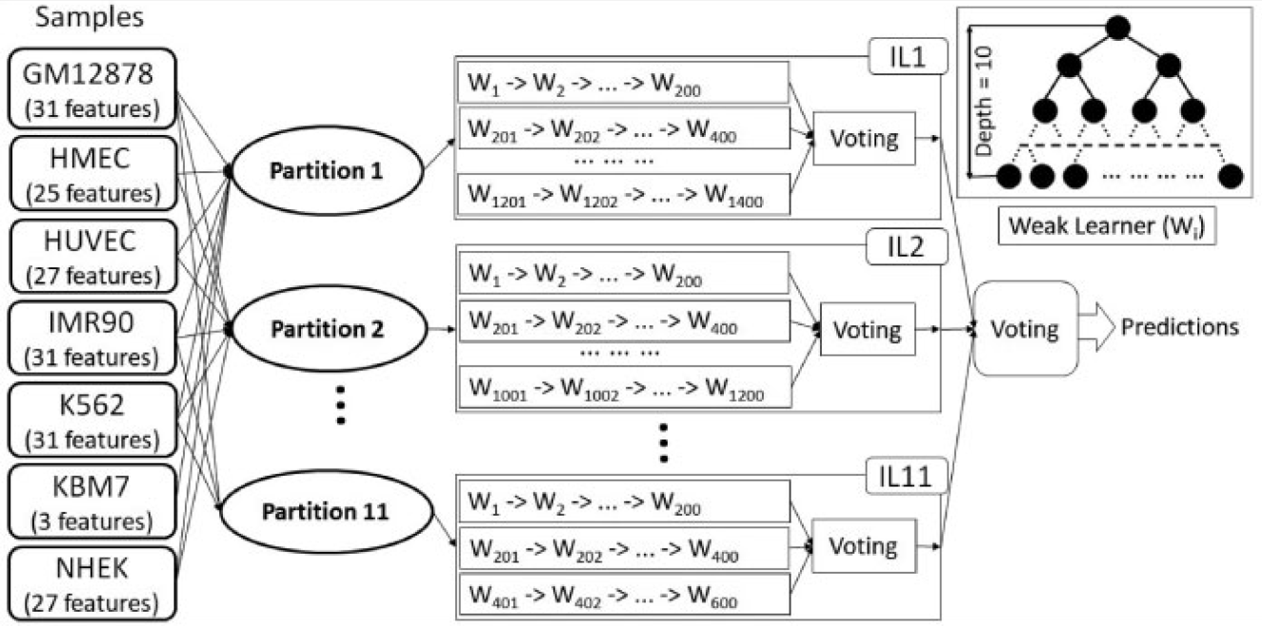
EPI – State-of-the-Art ML approach
Input for model
Enhancer-Promoter pair features for 7 cell lines
3D Chromatin Interaction features
Epigenomic features
Partitions
Partitions with overlapping feature set are used
11 in total
Incremental Learner (IL)
Each IL trained on each partition
Contains 200 Weak leaners (W_{i}), Decision Trees
Result is the voting of all the W_{i}(s)
Model Prediction
Result is the voting of all 11 ILs
Fig: Architecture of EPIP, proposed by Talukder et. al. [8]
Notes:
Let us now look at one State-of-the-art Machine Learning approach, called EPIP, proposed by Talukder et. al.
It is quite a complex ensemble method, with two stages of voting.
Here, the features considered as input to the model are Epigenomic features, along with 3D Chromatin interaction information.
The experiment was done with data from 7 different cell-lines in Human.
The data from these cell lines are merged and partitioned into 11 groups.
As you can see in the architecture, each cell-line has different number of features available to them.
Hence, in each of these partitions, only the overlapping features are used.
Now, each partition is then passed through a separate Incremental Learner.
Here, the incremental learner consists of 200 weak-learners. Each weak learners can, for example, be a pruned decision tree.
The vote of these 200 weak learners forms the classification output of a Incremental Learner.
Since there are 11 partitions, there also exists 11 Incremental Learners.
Hence, the final classification output is considered to be the vote of these 11 Incremental Learners.

Slide 10
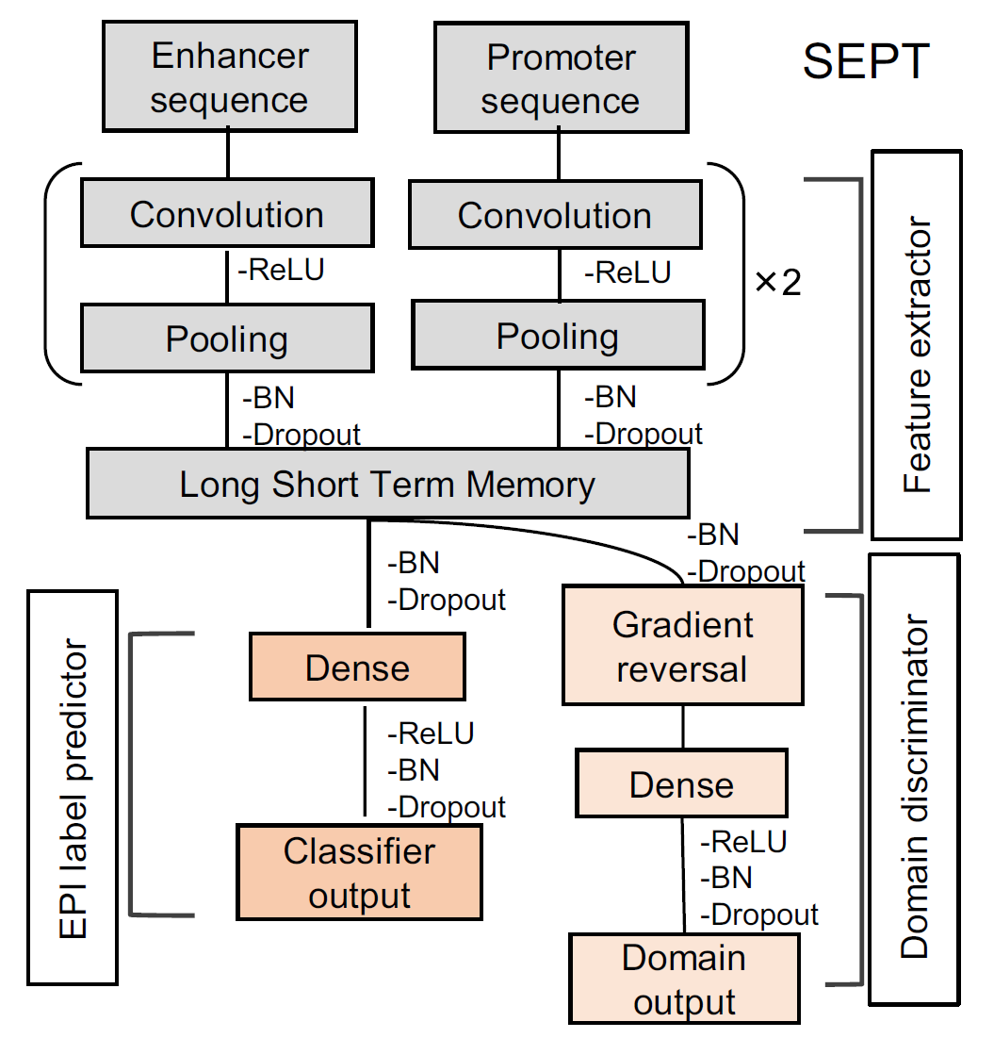
EPI – State-of-the-Art DL approach
Input to network
Enhancer and Promoter sequence segment from DNA
One-Hot Encoding of segment
Feature Extractor
Multi-path, multi-layer architecture
CNN processes Enhancer and Promoter sequences separately, parallelly
RNN processes combined features
Domain Discriminator
Removes cell-line specific features
Retains global features for EPI
Gradient Reversal Layer
EPI Label Predictor
FCNN layer
Fig: Architecture of SEPT, proposed by Jing et. al. [9]
Notes:
Now, let’s look at one State-of-the-art Deep Neural Network approach, called SEPT, proposed by Jing et. al.
It is a multi-stage, multi-path architecture, as you can see on the architecture here.
The input to the network is the individual Enhancer and Promoter segments of fixed length extracted from the DNA sequence.
During the feature extraction stage, the Enhancer and Promoter are individually processed through 2 convolutional layers.
Then, the results are concatenated and passed through a LSTM layer to learn temporal dependencies.
Finally, a dense layer is used to classify the Enhancer promoter pair as interacting or not.
One thing to note, is that most of the approaches we studied follow a similar architecture of extraction and prediction, but with certain novelties.
For e.g., SEPT, here, introduced an additional Domain Discriminator layer.
The reason behind it is that like in the last ML approach, here also data from multiple different cell lines of human beings are used for the experiment.
Now, it has been seen that Enhancers and Promoters of different cell-lines can have some features in common, and also some distinct features.
So that the network learns to extract only the features common across all cell-lines, this gradient reversal layer as the discriminator has been introduced.

Slide 11
EPI – Performance of Global models
Notes:
Now we look at the performance of various approaches we surveyed across 6 cell lines in human beings.
One thing to note here, is that we did not report performance of all the methods we surveyed, because not all methods reported the common metrics that is most frequently used in this use-case,
namely Area UNDER THE RECEIVER OPERATING CURVE, and Area under the Precision-Recall curve.
Now, there are two types of training and prediction strategies that researchers employ.
One method is training on data combined from all available cell-lines, and then predicting on all of them. We call these the Global models.
The second method, is where models are trained only on specific cell lines and then prediction performance is tested on the same cell line it is trained upon.
However, not all methods employed both.
In the 1st approach, where all cell-lines are combined to train the Global models, SEPT does it a bit differently.
It trains by combining all cell-lines except for the one it is reporting the prediction performance upon.
This is why, although SEPT is the state of the art, the performance numbers show a small dip across the board compared to others here.
However, following the same training strategy, SEPT showed that all other methods have significantly lower performance in their experiments.

Slide 12
EPI – Performance of Cell-line-specific models
Notes:
Now, coming to cell-line specific method, we find that EPIP, which is the state-of-the-art Machine Learning approach introduced earlier, performs significantly better than the others across the 5 cell lines the performances have been reported upon.

Slide 13
Ψ-site – Features
RNA Sequences as feature
Long sequences, consisting of 4 nucleobases
Adenine [A] , Cytosine [C],
Guanine [G] and Uracil [U]
Fixed length segments used as input
…..ACGACUAAACCACGUACGACUAAACCACU…..
Genomic features
WHISTLE
PIANO
Structural context of mRNA
RNA Sequence encoding schemes as features:
Nucleotide Binary Profiles
Nucleotide Density
Accumulated Nucleotide Frequency
Electron-Ion Interaction Pseudopotentials
Nucleic Acid Composition
Enhanced Nucleic Acid Composition
Di-Nucleotide Composition
Tri-Nucleotide Composition
Nucleotide Chemical Property
Position Specific Nucleotide Propensity
Xmer k-spaced Ymer Composition Frequency
Clustering information of RNA segments
Notes:
Okay, so now let us move on to the next classification task, which is the prediction of Pseudouridine sites in RNA.
Similar to the last task, in this case as well, segments of RNA Sequence is one kind of feature directly used in the approaches.
Even Genomic features are used as well.
Additionally, sequence encoding schemes to encode physico-chemical composition and properties of the RNA sequences are also used as a set of features.
Furthermore, Context of Structure and Clustering information is also employed by certain approaches.

Slide 14
Ψ-site – Classifiers
Machine Learning approaches
Uses feature sets directly
Requires crafted features
Requires domain expertise
Feature Selection performed
To filter relevant and important features only
Forward feature selection
Light Gradient Boosting Machine
Prevalence of Ensemble algorithms for classification:
Random Forest
Extreme Gradient Boosting (XGboost)
Ensemble of different algorithms
Deep Learning approaches
Uses feature sets directly
Do not require hand crafted features
Feature Extraction layer
Learns and extracts features directly from data
Convolutional Neural Network layer
Extracts spatial features from sequences
Fully Connected Neural Network layer used for final classification
Notes:
For Psi-site prediction also, current research implements algorithms from Machine Learning, as well as innovate deep neural networks architectures.
For Machine Learning algorithms, Feature selection methods, like Forward Feature Selection and Ensemble methods like Light Gradient Boosting Machine algorithms are used to determine relevant and important features.
Whereas, for Neural Networks, Convolutional Neural Network Layers are majorly used to learn and extract spatial features in the sequences.
However, unlike the last task, Recurrent Neural Network layers are not implemented to extract temporal dependencies within the sequences.
Similar to the last task, in the case of Machine Learning, the classifiers are often a variety of ensemble methods.
And, for the deep learning approaches, it is usually performed using Dense fully connected layers.
Here we surveyed 8 different methodologies for predicting Psi-sites.

Slide 15
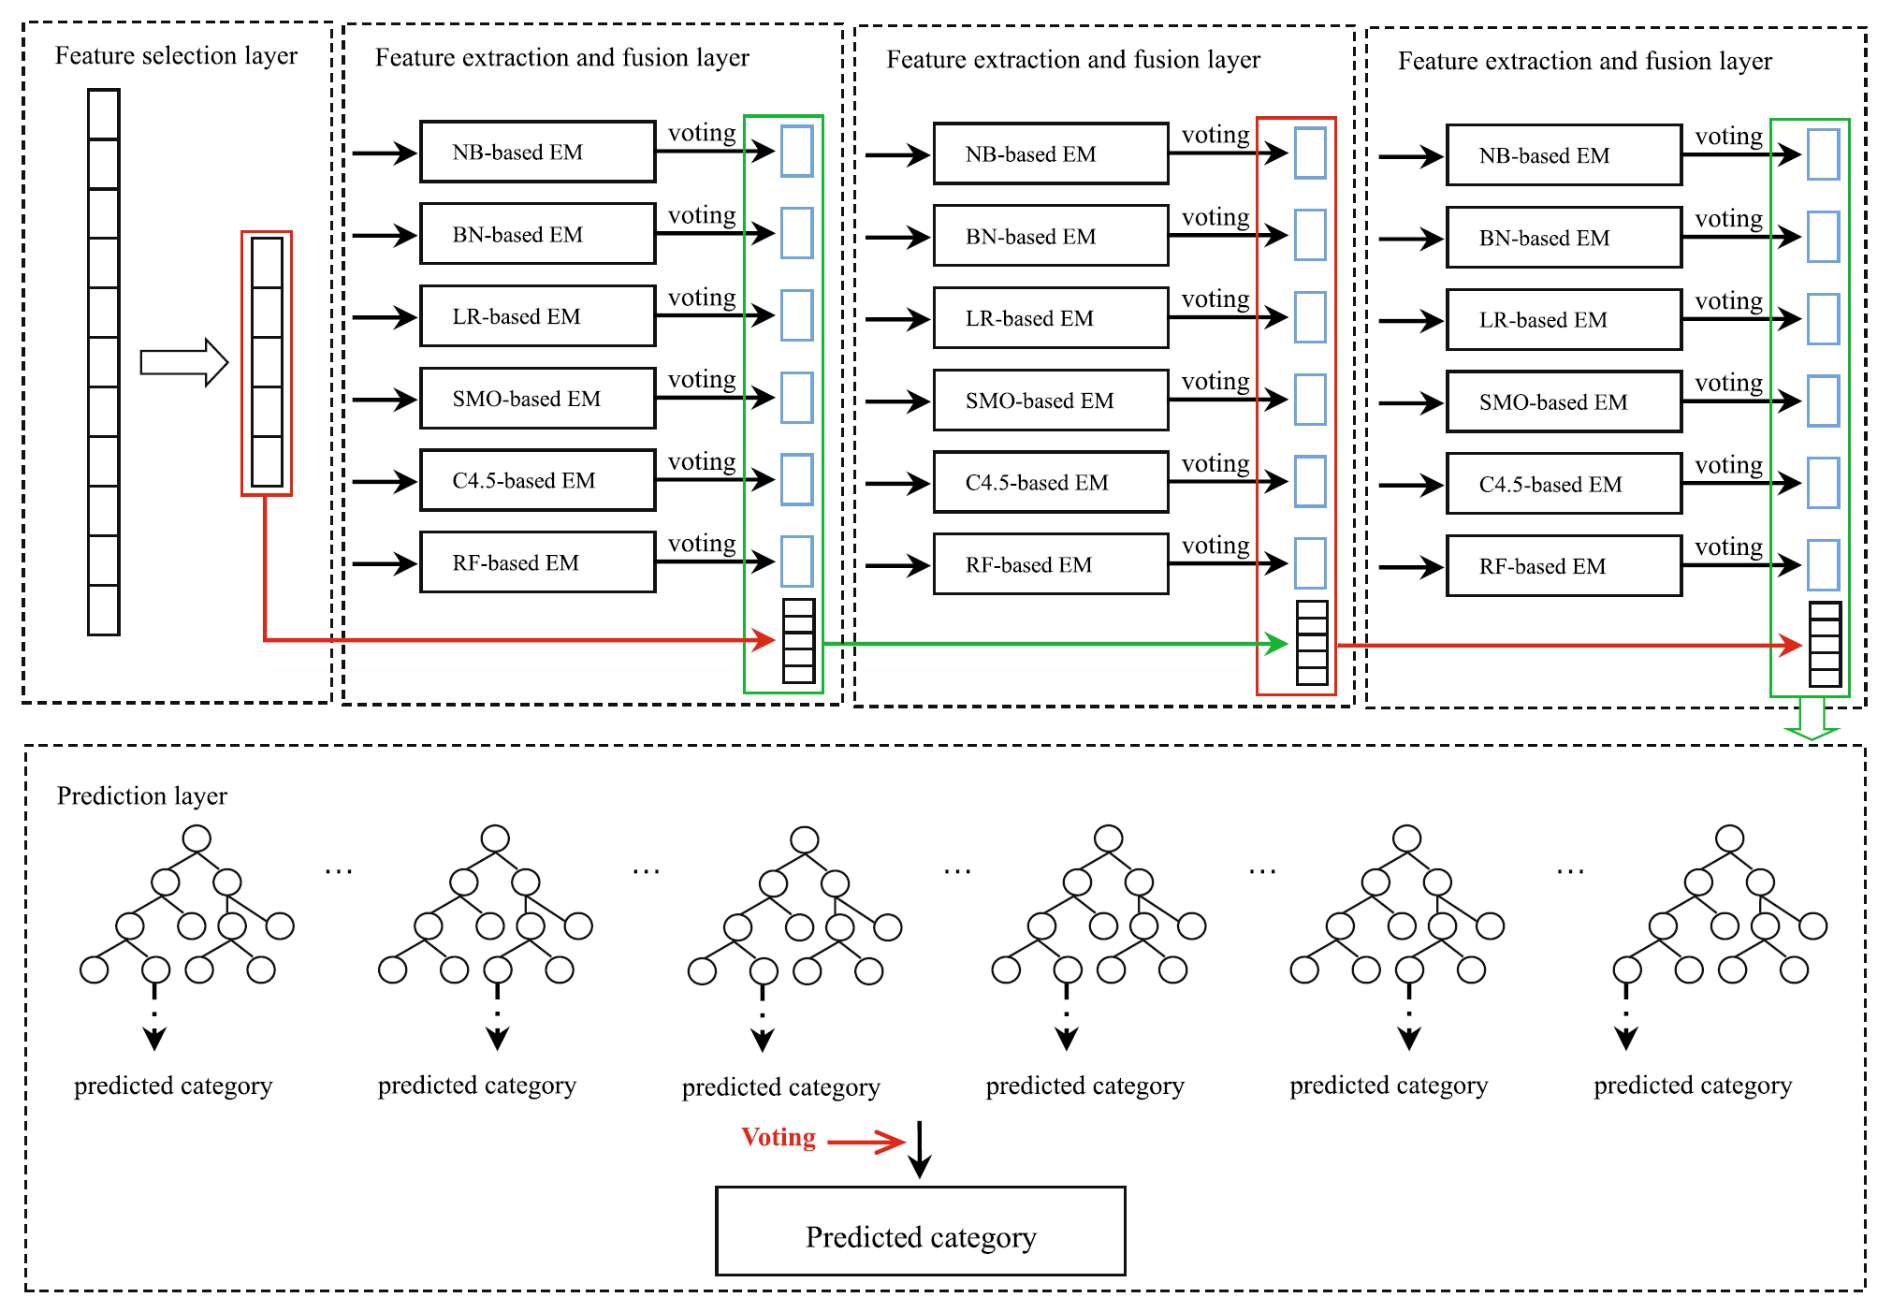
Ψ-site – State-of-the-Art ML approach
Input for model
RNA Sequence encoding schemes on segments
Feature Selection layer
Correlation based Feature Selection (CFS) algorithm
Greedy hill-climbing augmented with backtracking
3 Feature Extraction and Fusion layers
6 ensemble ML algorithms
Voting based feature generation
Contains Skip connections
Prediction layer
Random Forest based final classifier
Fig: Architecture of iPseU-Layer, proposed by Mu et. al. [10]
Notes:
Let us now look at one State-of-the-art Machine Learning approach, called iPseU-Layer, proposed by Aziz et. al.
This is also a complex ensemble method.
The first layer is a greedy-hill-climbing layer for Correlation Based Feature Selection.
The novelty is in the next Feature extraction and fusion layer which generates vote based binary features using 6 ensemble algorithms.
Additionally, features from previous layers are also kept intact using skip connections and concatenations.
At the end, the final classification task is performed using Random Forest.

Slide 16
Ψ-site – State-of-the-Art DL approach
Input to network
RNA Sequence encodings, concatenated:
One-hot Encoding
Merged-seq Encoding
Feature Extractor
Multi-layer architecture
CNN processes the sequence vectors
Different sized kernels capture spatial information at different resolutions
Ψ-site Label Predictor
2-layer architecture
FCNN layer
Fig: Architecture of Merged-seq, proposed by Aziz et. al. [11]
Notes:
Now, let’s look at one State-of-the-art Deep Neural Network approach, called Merged-seq, proposed by Aziz et. al.
It is a multi-path architecture, as you can see on the architecture here.
The input to the network is the individual segments of fixed length extracted from the RNA sequence in one-hot-encoded vector format.
The novelty, is the addition of Merged-seq encoding based on secondary structure of the RNA segments, which is concatenated along with the OHE vectors to form the input.
During the feature extraction stage, the segments are processed through n convolutional layers and then concatenated.
Finally, a two stage dense fully connected layer is used to classify the RNA segments as Psi-sites or not.
Unlike the EPI task, we see that much simpler neural networks are employed for this prediction task.

Slide 17
Ψ-site – Performance of approaches
Notes:
The training strategy applied here is always cell-line specific.
For the evaluation of performance, most researches report four metrics, Accuracy, Sensitivity, Specificity and Mathew’s Correlation coefficient (balanced measure, hence useful for imbalanced datasets). It is usually tested on 3 standard input datasets, from Humans, House mice and Yeasts.
Out of the 8 methods, two methods do not report these 4 metrics mentioned here.
From the results, we can see that the two state of the art methods discussed, iPseU-Layer and Merged-seq outperform other methods significantly.

Slide 18
Ψ-site – Performance of approaches
Notes:
Moreover, 4 methods also report performance on 2 independently generated datasets, from Humans and Yeasts..
Even here, the trend is not that crisp.

Slide 19
Conclusion
State of the art
Huge repository of in-silico methods for prediction of EPI and Ψ-sites in DNA and RNA sequences respectively
Trend: Machine Learning approaches focus on Ensemble methods
Advent of Deep Learning, to learn important features from data
DL approaches out-perform ML approaches
Issues with surveyed researches
Performance of approaches not comparable directly in some instances
Non-uniform set of metrics and datasets among evaluation of approaches
Need consensus in community to structure these aspects to identify progress clearly
Further research opportunities
Comparison between predictive power of different types of features
Analyze if certain type of feature, or a hybrid set of features outperforms others
Application of RNN and hybrid layers for Ψ-site prediction, like in EPI
Application of Natural Language Processing embeddings for Ψ-site prediction, like in EPI
Notes:
To conclude, we surveyed and recognized many in-silico methods for EPI prediction and Psi-site identification, among a huge repository of methods.
In general, we see that ML approaches tend towards ensemble methods, given their obvious advantages.
Furthermore, Deep Learning approaches have supplemented hand-crafted features with learned features.
However, we did see that there is some need of consensus for experiments to report evaluation on standard datasets using widely used metrics, so that the state-of-the-art is easier to identify.
Furthermore,
We do see some research opportunities as well.
To begin with, the predictive power of each of the different types of features that we discussed earlier, like direct sequences, genomic and epigenomic features, 3D interation and structure data, etc. need to be analyzed.
Specifically, for Psi-site identification, use of Recurrent Neural Network layers to learn temporal information can be tested.
Even the application of Natural Language Processing based word-embeddings can be explored for Psi site identification.
For Enhancer Promoter Interaction, use of attention mechanisms with the RNN layers can also be explored as an attempt to get more performance out of the models.

Slide 20
Thank you for your time!
Questions?
Notes:
That is all I have for today.
Thank you for your time and attention.
So, questions?

Slide 21
References
Science Learning Hub – Pokapū Akoranga Pūtaiao, University of Waikato, www.sciencelearn.org.nz
Cytogenetics, Università degli Studi di Napoli Federico II
Emmanuel Barillot, Laurence Calzone, Philippe Hupé, Jean-Philippe Vert, Andrei Zinovyev, Computational Systems Biology of Cancer Chapman & Hall/CRC Mathematical & Computational Biology , 2012
Wilson, Edmund B. (1900) The cell in Development and Inheritance (2nd ed.), Category: New York: The Macmillan Company
Bernstein. (2021). Regulation of transcription in mammal. CC-BY-SA-4.0 Wikimedia Commons, Creative Commons Attribution-Share Alike 4.0 International license. https://bit.ly/2WyfJ0k
Stuart, K. et al. Complex management: RNA editing in trypanosomes. Trends in biochemical sciences 30 2 (2005): 97-105 .
Zhao, Yang & Dunker, William & Yu, Yi-Tao & Karijolich, John. (2018). The Role of Noncoding RNA Pseudouridylation in Nuclear Gene Expression Events. Frontiers in Bioengineering and Biotechnology. 6. 10.3389/fbioe.2018.00008.
Talukder, Amlan \& Saadat, Samaneh \& Li, Xiaoman \& Hu, Haiyan. (2019). EPIP: A novel approach for condition-specific enhancer-promoter interaction prediction. Bioinformatics (Oxford, England). 35. 10.1093/bioinformatics/btz641.
Jing, Fang \& Zhang, Shihua. (2020). Prediction of enhancer–promoter interactions using the cross-cell type information and domain adversarial neural network. BMC Bioinformatics. 21. 10.1186/s12859-020-03844-4.
Mu, Yashuang \& Zhang, Ruijun \& Wang, Lidong \& Liu, Xiaodong. (2020). iPseU-Layer: Identifying RNA Pseudouridine Sites Using Layered Ensemble Model. Interdisciplinary Sciences: Computational Life Sciences. 12. 10.1007/s12539-020-00362-y.
Bin Aziz, Abu Zahid \& Hasan, Md. Al \& Shin, Jungpil. (2021). Identification of RNA pseudouridine sites using deep learning approaches. PLOS ONE. 16. e0247511. 10.1371/journal.pone.0247511.

